Slide 1
Social media’s effect on the election.
Ashley gentle

Slide 2

“Did social media ruin the election 2016?”
Over the past very years we have seen a growth in the end of friendship over politics. People saying things like “just unfriend me know” or “congratulations you survived my friend purge”.
Twitter has caused people to shame or bash people for there political believe. It’s a nasty cycle of political bashing, that people today seem to revel in.
Trump has taken this reveling in political chaos on social media as a way to get ahead during his election. President trump is one of the most combative candidates on social media in history.

Slide 3
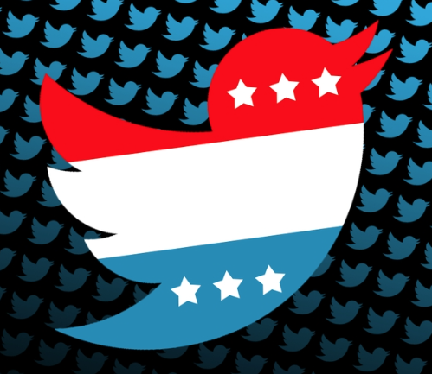
“Did social media ruin the election 2016?”
trumps main effect on social media during the 2016 election was on twitter.
The 2016 election was one of the most bashing campaigns in history due to its social media present.
The way social medias like twitter are used today is not how the creators intended for it to be used.

Slide 4
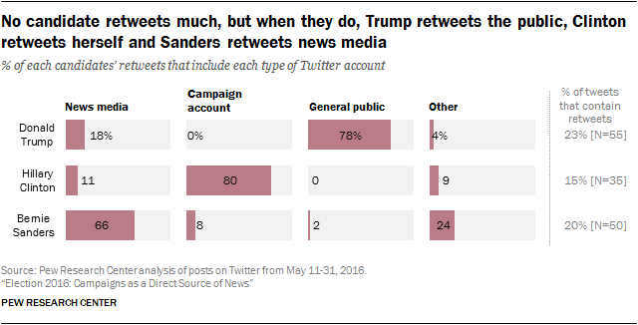
Sanders, Hillary and Trump all use social media differently.
During the 2016 election trump, Hillary and sanders all took there campaign to social media.
Trumps “general public” percentage was higher than any other candidate.
Sanders had the highest percentage in “news media”, and Hillary had the highest percentage in “campaign account”

Slide 5
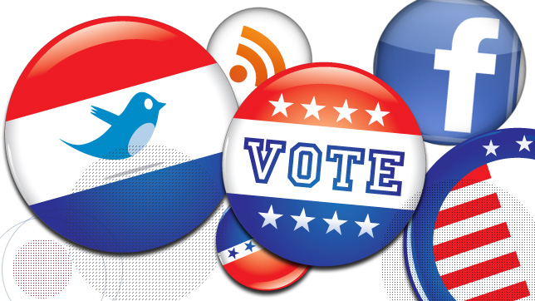
“Candidates differ in their use of social media to connect with the public”
In January of 2016 44% of adults said that the learned about the election through social media.
As of July 24% said that they learned everything about the campaign through Hillary or trumps social media.
During May 11th-31st of 2016 of the 3 candidates put together there was 714 tweets and 389 Facebook posts

Slide 6
Bibliography
http://www.npr.org/2016/11/08/500686320/did-social-media-ruin-election-2016
(1st article)
http://www.journalism.org/2016/07/18/candidates-differ-in-their-use-of-social-media-to-connect-with-the-public/
  (2nd article/chart)

