Slide 1
Place Header Image First
(Size to Grey Box)
Place Profile
Image Second
(Size to Grey Box)
Don’t Breath
@Don’tBreath
Don’t Breath @Don’tBreath
Want to be sitting on the edge of youre seat all night? Don’t breath is the move for you.
A movie about 3 teenagers that try to break into a blind man’s house….but nothing goes as planed.
Don’t Breath @DontBreath
Breaking the rules always has concicounces unfortunatly theres was worse.
Don’t Breath @Don’tBreath
A movie full of suspense come see Don’t Breath in theaters today.

Slide 2
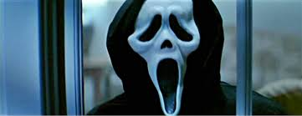
Place Header Image First
(Size to Grey Box)
Place Profile
Image Second
(Size to Grey Box)
Scream
@Scream
Scream @Scream
Every wanted to see most people nightmare come true come see scream today
A small town with little trouble suddenly errupts with a mass serial killer…. Who could it be?
Name@Username
Want to be screaming all night? Screams in theaters today.
Scream @Scream
Get ready to scream you’re lungs out today when you see scream.

Slide 3
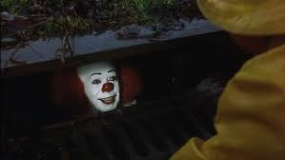
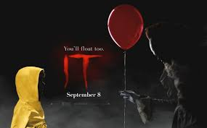
Place Header Image First
(Size to Grey Box)
Place Profile
Image Second
(Size to Grey Box)
IT
@IT
IT @IT
Come watch 7 kids face there biggest fears in hopes to safe there town.
An ancient evil emerges every 27 years to prey on children and this time its up to 7 kids to face there fears and beat it.
IT @IT
Come see IT today in theaters you wont regret it.
IT @IT
Come play with no ones favorite clown get you’re tickets today.

Slide 4
Place Header Image First
(Size to Grey Box)
Place Profile
Image Second
(Size to Grey Box)
American horror story @americanhorror story
American horror story @americanhorrorstory
“we are all freaks” so come watch American horror story with us.
American horror story @americanhorrorstory
A horror story were every season is a new thing to terrify you.
Come watch us for a night of scares.
American horror story @americanhorrorstory
The show you have to watch to believe.

